Slide 1
Mike Tung - founder+ceo

Slide 2
What is diffbot?
We apply computer vision techniques to analyzing web pages, making web data useful for content applications.

Slide 3
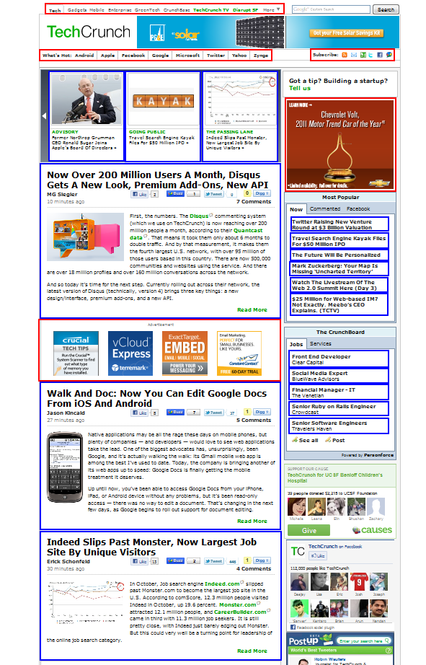
Technology Characteristics
Visual features
Structural features
Statistical classification
Language-independent
Formats-independent

Slide 4
Demo: Article API
http://diffbot.com/docs/api/article

Slide 5
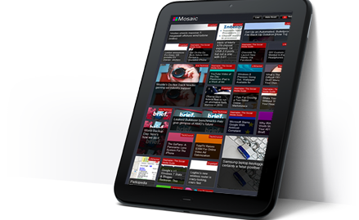
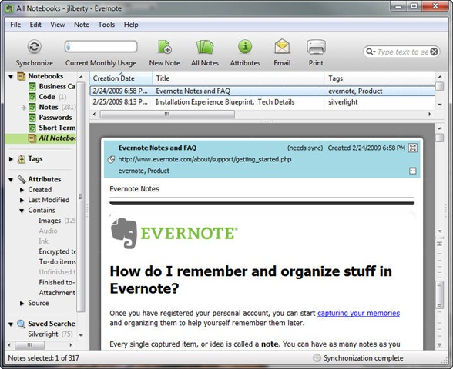
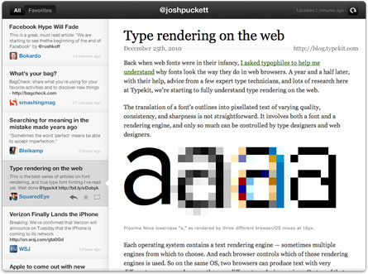
What’s It For?
Content and semantic applications
Syndication

Slide 6
How are developers using it?
Content readers | 40%
Syndication and alerting | 20%
Vertical aggregators and search | 10%
Building corpuses from web (e.g. NLP/IR research) | 5%
OTHER | 25%

Slide 7
What’s Next?
Goal: understand all types of web pages
Events
Directories
Products
Albums and Videos
More!
Constantly improve learning of models and release technology via API
SkyNet!

